Slide 1
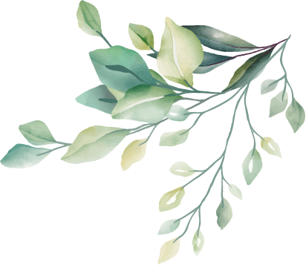
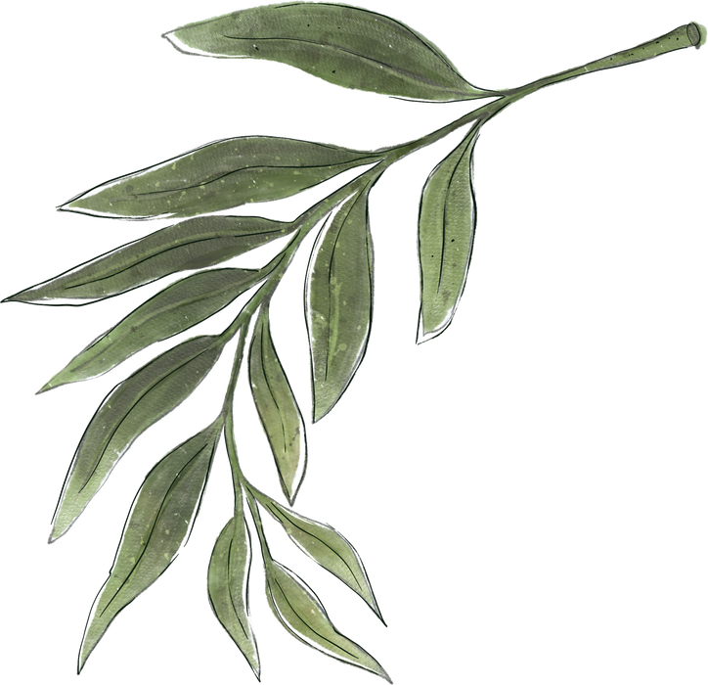



The History Of Milltown N.S.
By Ellie,Cadhla & Maisie

Slide 2


How it started
Milltown N.S. was built in 1965, but before that where did the locals go to school? They either went to the school on the Shan road (old Milltown), Irishtown school or Newbristy school.

Slide 3

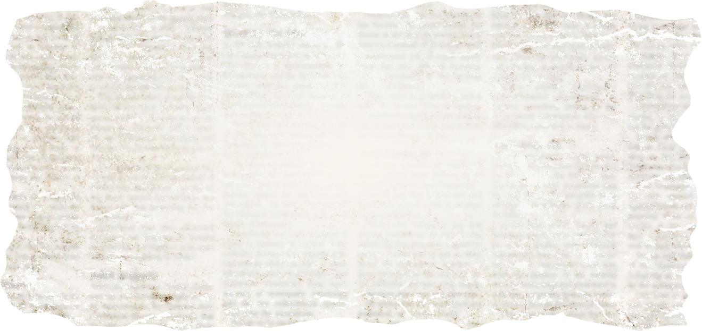


About the Old School
The school hours were 9:30 am to 3pm. In each classroom there was a stove/ open fire at the top of the classroom where the teacher use to sit and the children at the back of the classroom were frozen with the cold. Their toilet used to be outside in a little shed and there was no lock on the door so you had to pray that nobody came in.

Slide 4
They used to play outside where the boys used to play football in the field behind the school and the girls used to play games like tig, red rover, marbles and hopscotch out the back as well or out the front where the apple trees were. There were two classrooms with one teacher in each room. That means that they each had 4 classes to teach.

Slide 5



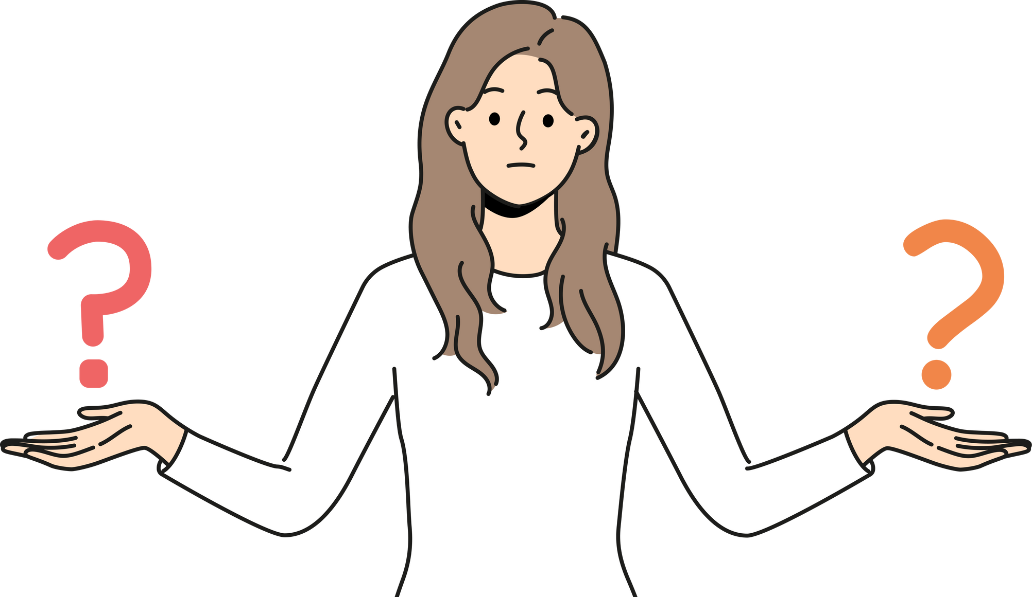
Things That Were Different
The only people in the area who had telephones were the priest and one of the teachers. You were really rich if your family owned a car. You had to write using an ink pot and then dip your pen into the ink and then write. People would often spill, splotch or make a mistake but there was no way to fix them. If you were bad you would get smacked by the teacher.

Slide 6

Famous People Who Went There
William J Mullaly joined in 1884, left in 1910. He was the first person to make a Concertina recording
Mick Foster came from Kildare for 5th and 6th in 1960.
He plays in a band called Foster and Allen with Tony Allen.

Slide 7


Fun Facts
Éamon DeValera’s wife danced in the old school when it became a hall.
They added toilets to the building in 1965.
Newbristy school is now a house.

Slide 8
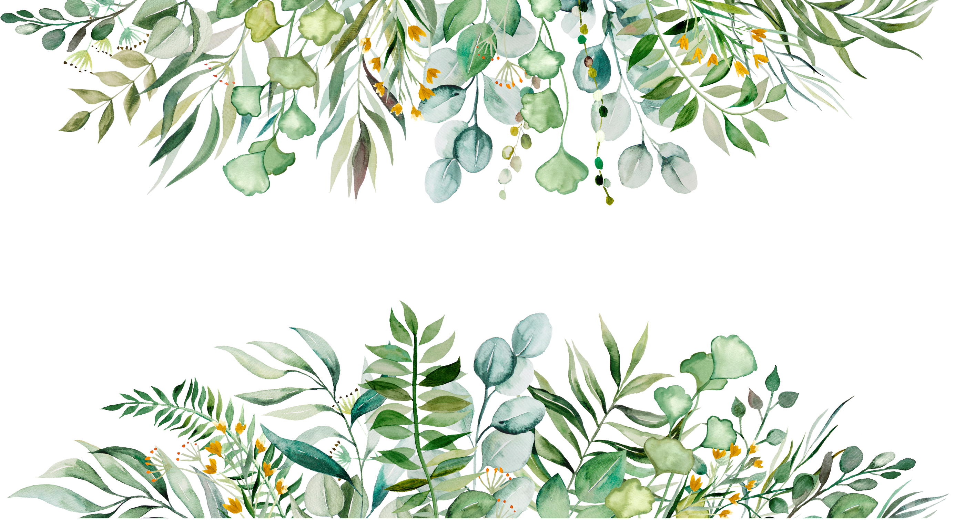
A Normal Day Back Then
You would have to get up early and help your dad on the farm and then if it was your day to serve you’d have to run down to mass for 8: 30. Then you would have to run home again, eat breakfast and run back to school.Normally you would have to walk through the fields to get to school. After school, you'd go home and eat dinner and then help your dad on the farm until bedtime.

Slide 9


Q: What was your school like?
A: At the time it was very old and there were only 2 rooms.
Q: What subjects did you get taught?
A: Irish, english, maths, geography, english grammar, irish grammar, sewing and knitting
Interview
With Cadhla’s grand aunt, Mary.
Q: How many people were in your class?
A: 10
Q: What age were you when you got your Communion/ Confirmation
A: 7/6th class
Q: How did you get to school?
A: Either my dad brought me or I walked
Q:What age did you start school at?
A:5 years old
Q: How many teachers were there?
A: 2
Q: What was your favourite game?A: Tig

Slide 10

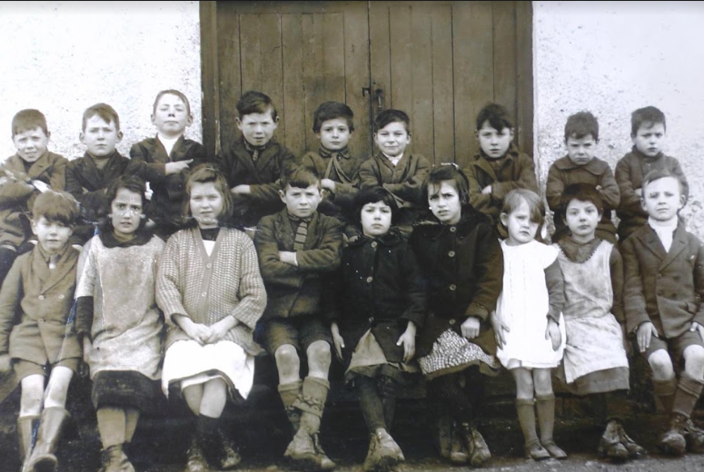
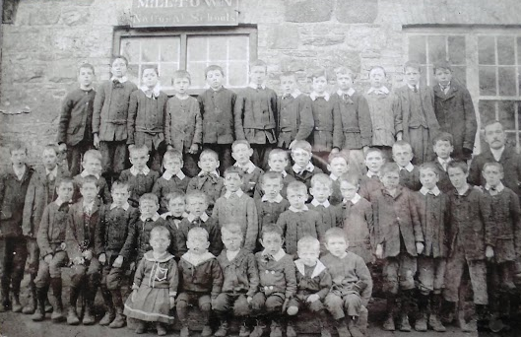

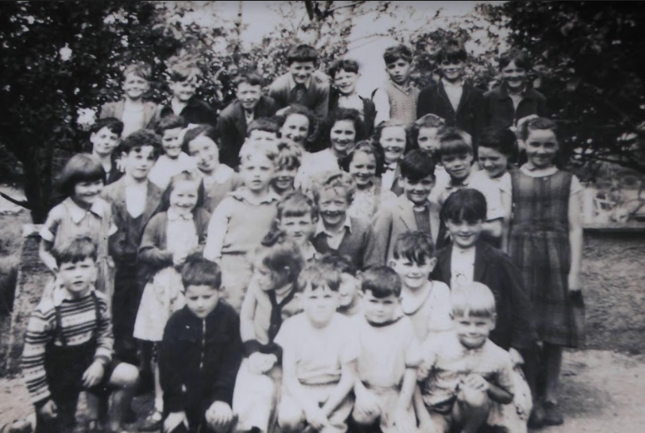
Pictures
1959 Bottom Left
1931 Top Right
1907 Top Left

Slide 11
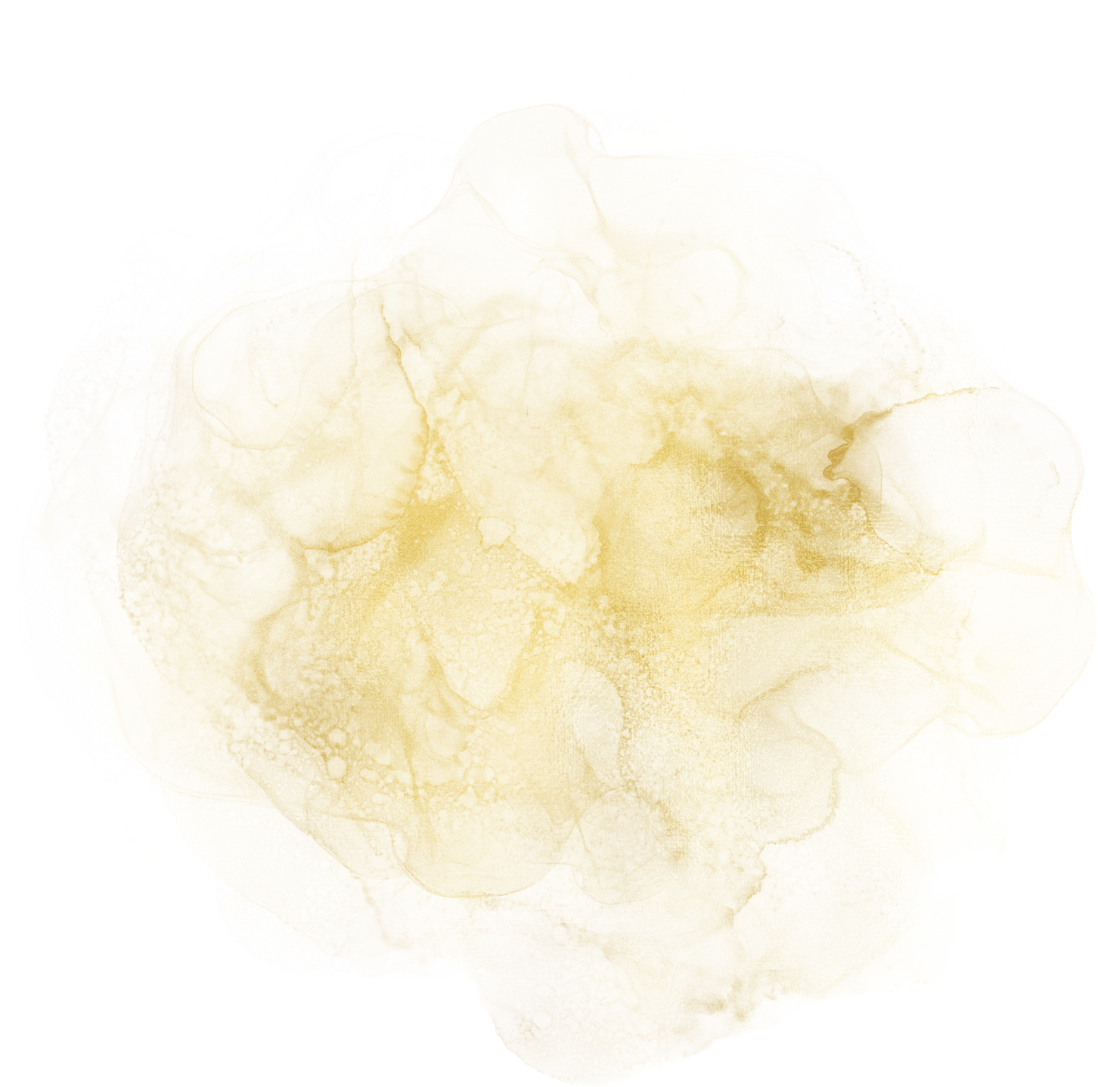
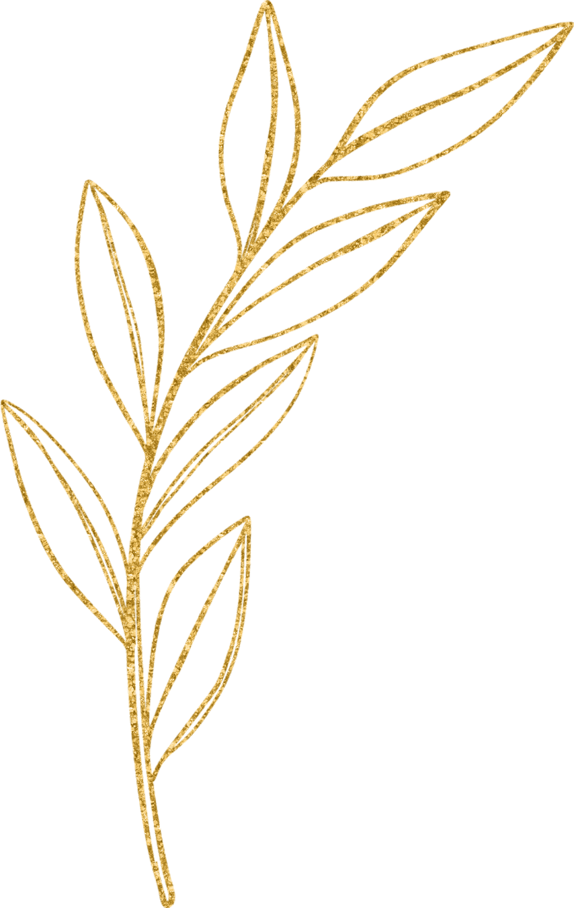

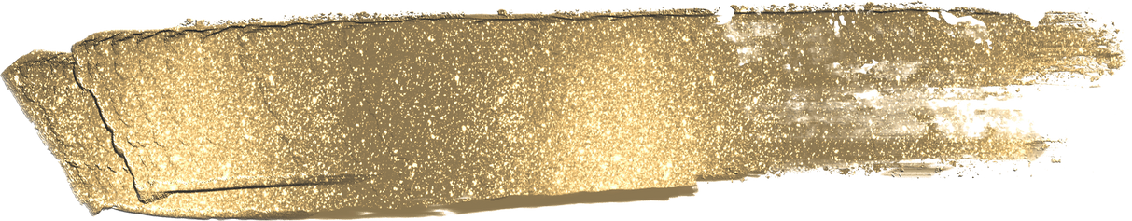
Milltown NS
In 1965, Milltown NS was built. At that time, all the pupils from the 3 local schools came together and made one big school.

Slide 12
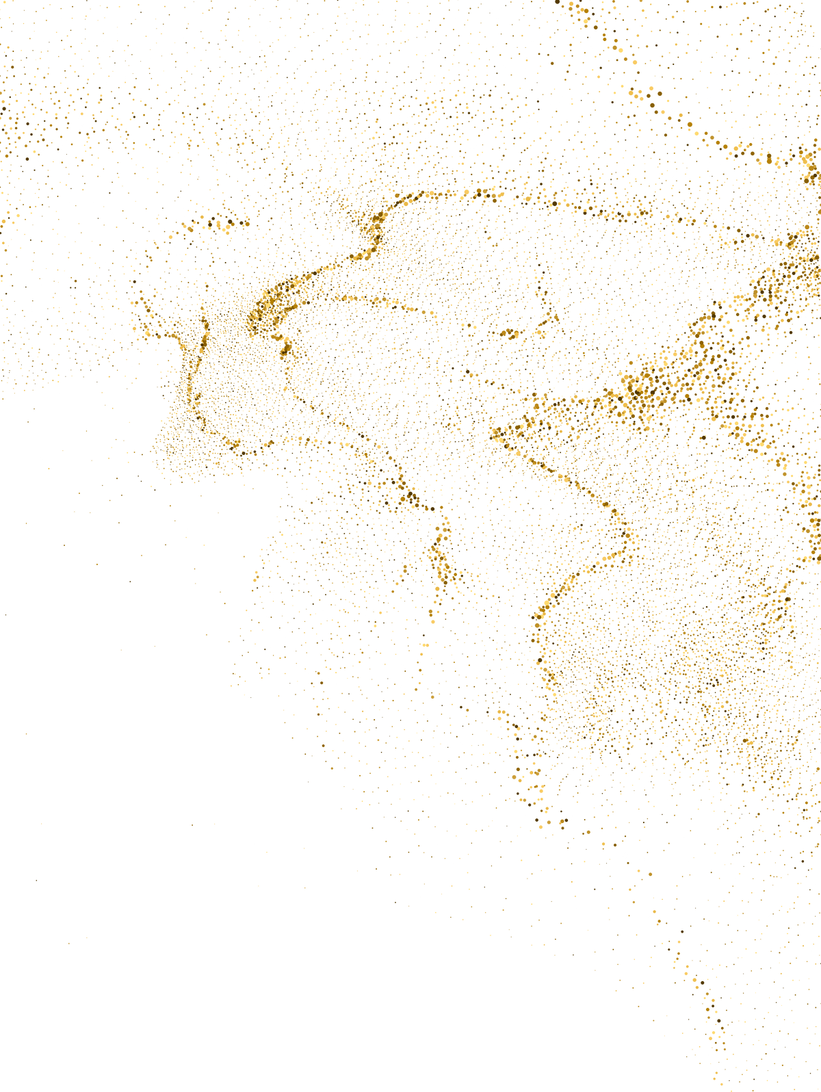



Question Time!

Slide 13


  What were the old school hours?
  Name the three schools that amalgamated.
  Who were the people in the parish who had telephones.

Slide 14
4. Who’s wife danced in the old Milltown hall?
5. What did Newbristy school turn into?

Slide 15
Thank You For Listening!

